Slide 1

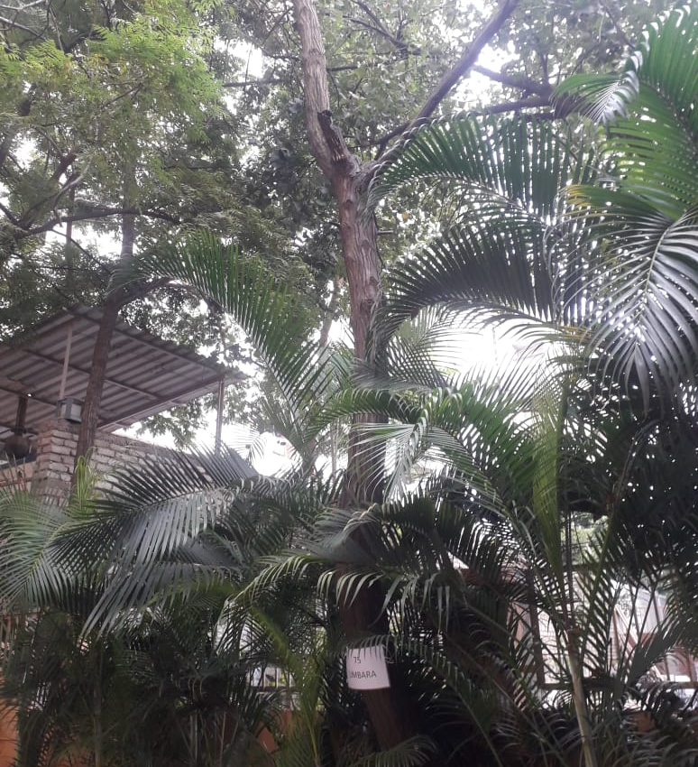
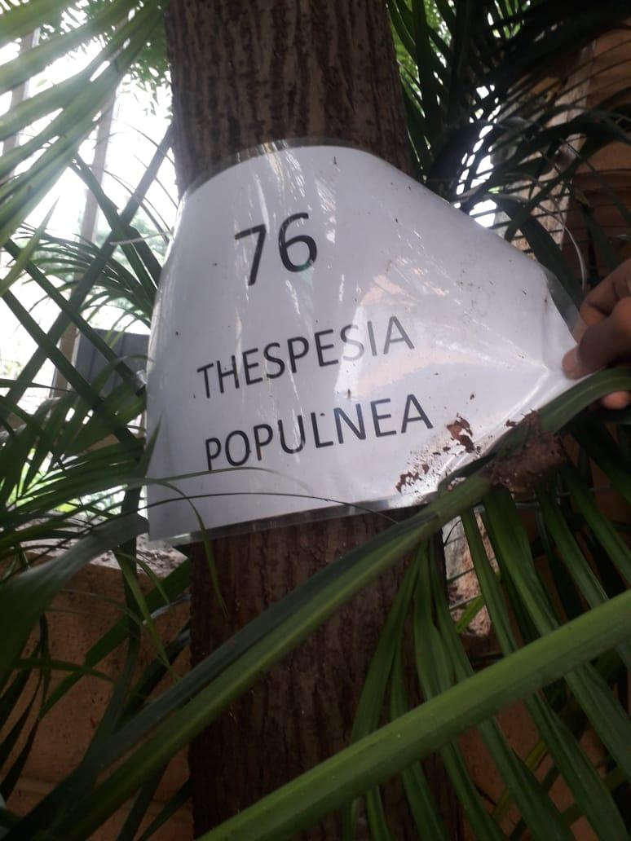
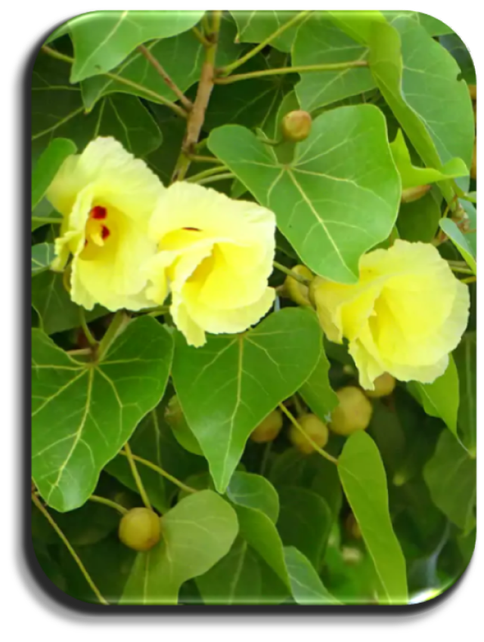
THESPESIA POPULNEA
Near assembly point 3 to assembly point 2 and upto new bld. Construction
AIS Campus, Wakad.

Slide 2
Common Name : Bhendi Gajadanda
Scientific Name : Thespesia Populnea
Family : Malvaceae
Habit : The tree is an Old World, tropical, coastal species and is often found near
mangroves. Its buoyant and hardy seed is adapted for oceanic dispersal.
Distribution : It is found in costal regions of Africa, tropical Asia, northern Australia,
Pacific Islands, Hawaii, Mexico, Colombia, West Indies, Florida, USA.

Slide 3
Description :
Height of Tree : It is a small tree or shrub reaching a height of about 10 m and up to 60 cm in trunk
diameter upon maturity.
Leaves : The leaves are thin, bluish green, and broadly heart-shaped.
Flower: The flowers are yellow, bell-shaped, and occur singly.
Fruits: Fruits are rounded capsules. Almost throughout the year, particularly at the beginning of the cold
season.
Bark of the tree : The bark is brown in colour
Seeds : The leathery seed capsules of Thespesia populnea are spherical and 1 to 2 inches in diameter.
The grayish brown seeds are 1/4 to 1/2 inch long.

Slide 4
Fruits: Yellow juice of the peduncles and fruits are useful in sprains, bruises and cutaneous diseases.
Flowers: The flower is medicinally used for the treatment of numerous diseases, including cutaneous infections, brain and liver disorders.
Bark: Decoction of the bark is given internally in chronic dysentery. Oil prepared by boiling the ground bark in coconut oil is applied in psoriasis and scabies. A compound oil of the bark and capsule is beneficial in cases of urethritis and gonorrhea.
Leaves: Ground leaves and contents of the capsule applied externally in eczema and ring worms.
Seeds: Seeds possess purgative properties.

